Slide 1

Food Establishment Prediction & Recommender
CKME136 - Capstone report
Certificate in big data and predictive analytics
Presented By - Mohammed Amir
Supervised By – Dr. Tamer Abdou
Ryerson University School of Continuing Education
April 17, 2017

Slide 2
Introduction
The common theme among technology based service providers is the reliance of a historical data & information in order to provide customer focused product and service
In these capstone project a subset of city of Toronto Dinesafe food hygiene inspection dataset was used to build a predictive and recommender system.

Slide 3
Dataset
The dinesafe dataset with over 16,199 rows of historical food inspection result of 2,715 food premises.
The data was for the year 2015 and 2016 inspection year.
The dataset had no customer profile or customer review and rating,
Rating & cuisine type data was collected from yelp and travel advisor sites manually and augmented to dinesafe dataset.
District and postal code was also missing from the dataset, these information was retrieved from Google using Google geocoding
http://www.toronto.ca/health/dinesafe/index.htm

Slide 4
ATTRIBUTE NAME | DESCRIPTION
ROW_ID | Represents the Row Number
ESTABLISHMENT_ID | Unique identifier for an establishment
INSPECTION_ID | Unique identifier for each Inspection
ESTABLISHMENT_NAME | Business name of the establishment
REVIEW | Customer satisfaction rating (1-5), 1 low, 5 high
VALUE | Value for money (1 - 5), 1 cheap , 5 expensive
CUISINE TYPE | Cuisine Type such as North American, European, African, Latin American, South Asian, Far Eastern etc…
ESTABLISHMENTTYPE | Establishment type ie restaurant, mobile cart
ESTABLISHMENT_ADDRESS | Municipal address of the establishment
ESTABLISHMENT_STATUS | Pass, Conditional Pass, Closed
MINIMUM_INSPECTIONS_PER_YEAR | Every eating and drinking establishment in the City of Toronto receives a minimum of 1, 2, or 3 inspections each year depending on the specific type of establishment, the food preparation processes, volume and type of food served and other related criteria
INFRACTION_DETAILS | Description of the Infraction
INSPECTION_DATE | Calendar date the inspection was conducted
SEVERITY | Level of the infraction, i.e. S – Significant, M – Minor, C – Crucial
ACTION | Enforcement activity based on the infractions noted during a food safety inspection
COURT_OUTCOME | The registered court decision resulting from the issuance of a ticket or summons for outstanding infractions to the Health Protection and Promotion Act
AMOUNT_FINED | Fine determined in a court outcome
ADDRESS | Full premises address
DISTRICT | Toronto district (Metro Toronto, York, North York, East York, Etobicoke, Scarborough)
CITY | Toronto
POSTAL CODE | Toronto postal codes

Slide 5
Methodology
Define Objective
Prepare and explore data
Data Cleaning
Missingness
Data Munging
Explorative Data Analysis
Univariant
Bivariant
Multivariant
Data Transformation
Data Normalization
Convert categorical to numerical
Develop Predictive Model
Create Recommendation
LANGUAGE
R language on RStudio

Slide 6
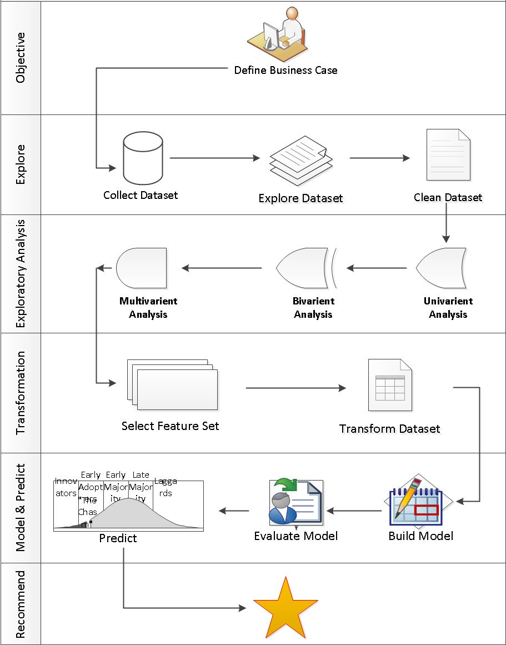

Slide 7
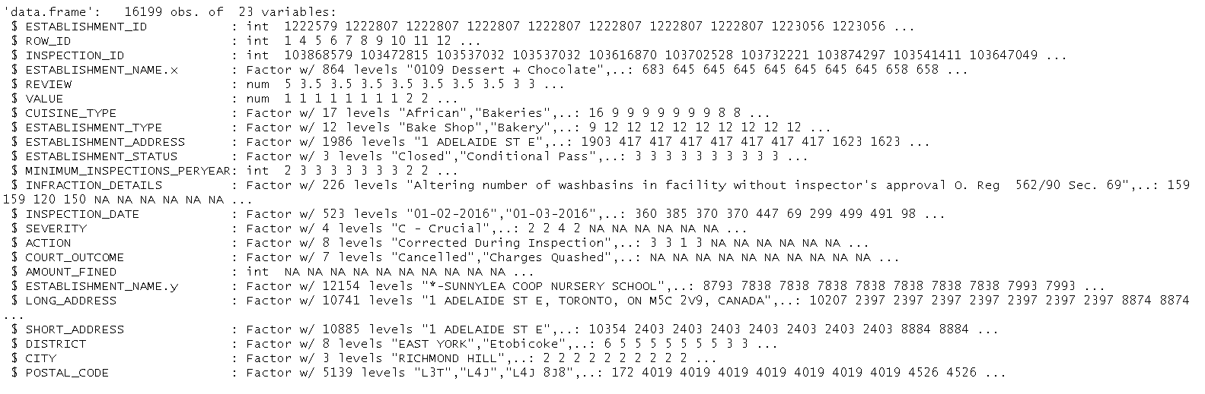
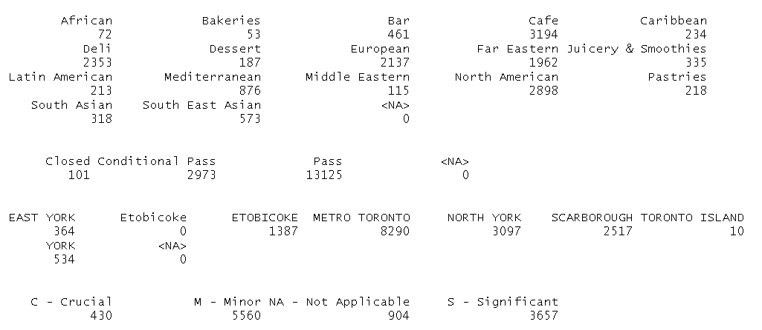
Data Exploration & Munging
Dataset Description

Slide 8
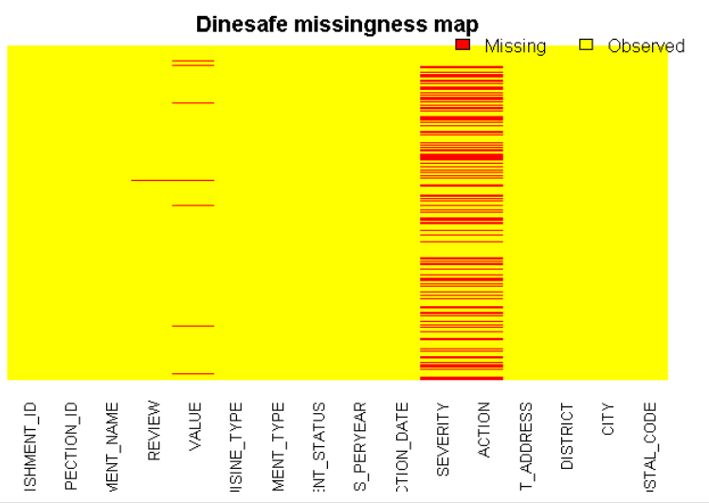
Data Exploration & Munging
MISSINGNESS
Missmap using Amelia package
IMPUTATION
Update missing “Review” & “Value” variables with mean value
Dinesafe$REVIEW[is.na(Dinesafe$REVIEW) & Dinesafe$CUISINE_TYPE=="African"] = mean(Dinesafe$REVIEW[Dinesafe$CUISINE_TYPE=="African"], na.rm=TRUE)
Update missing “Action” & “Severity” variables based on “Inspection Status”
Dinesafe$SEVERITY[is.na(Dinesafe$SEVERITY) & Dinesafe$ESTABLISHMENT_STATUS == "Pass"] = "NA - Not Applicable"

Slide 9
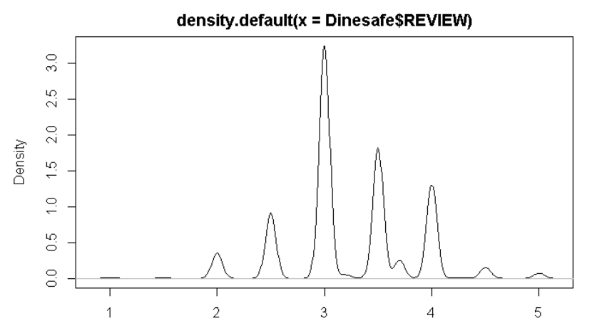
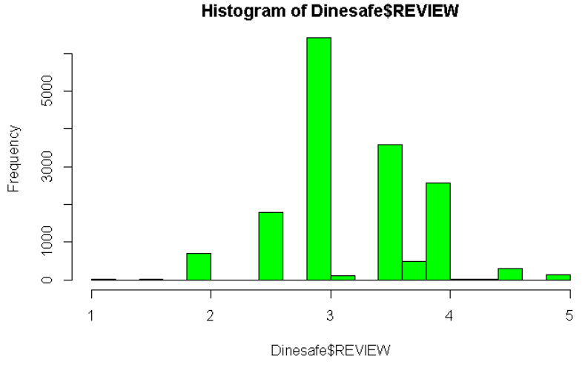
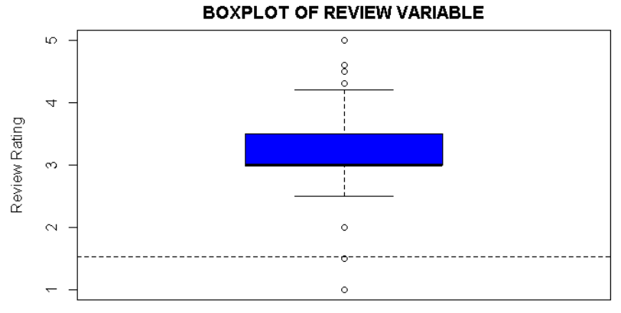
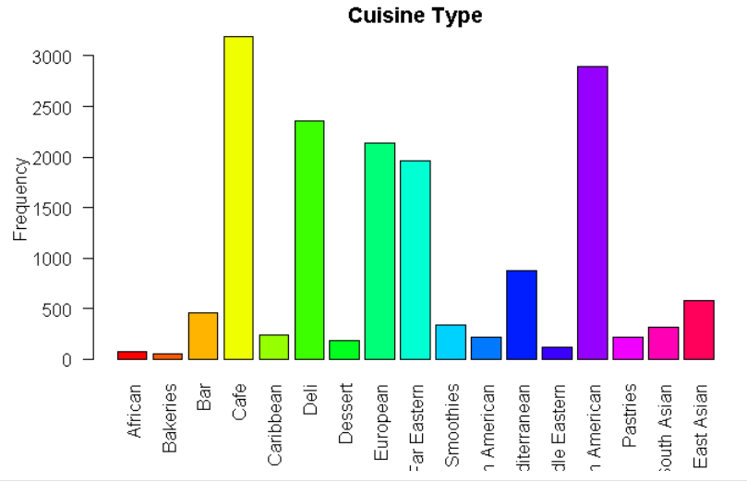
Univariate Data Analysis
Single variable data analysis
Density distribution
Histogram frequency distribution
Histogram frequency distribution
Box & Whisker plot graph

Slide 10
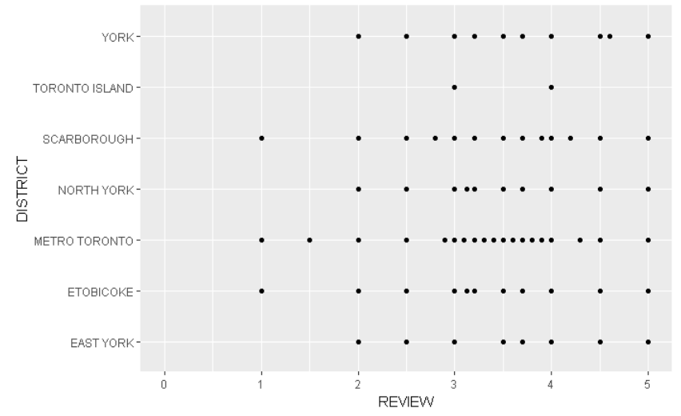
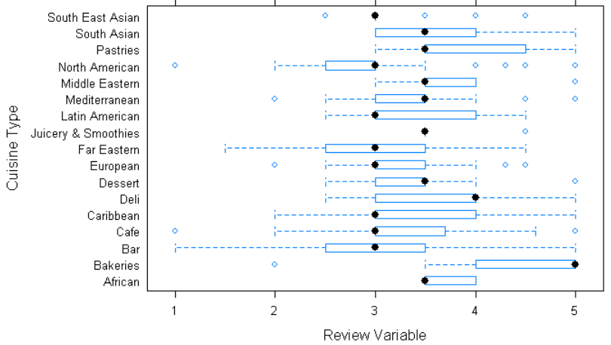
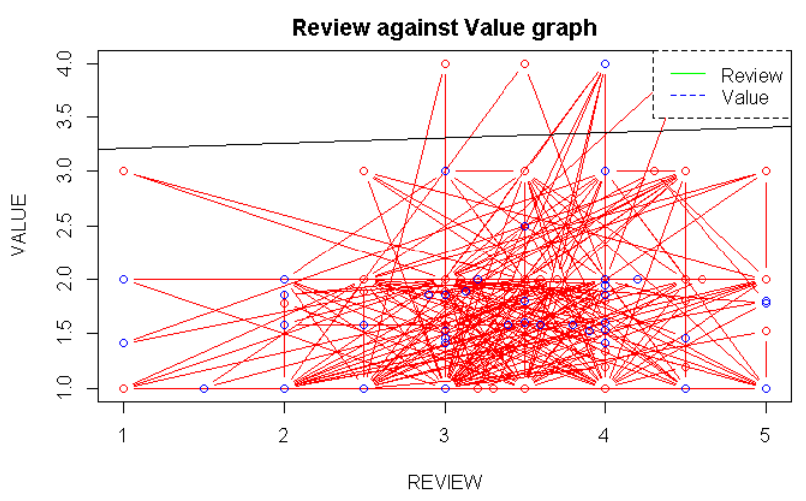
Bivariate Data Analysis
Two variable data analysis (categorical & numerical) with graph plot
Relationship between Review & Value with box plot & qplot plot
Relationship between Review & Value with scatter plot

Slide 11
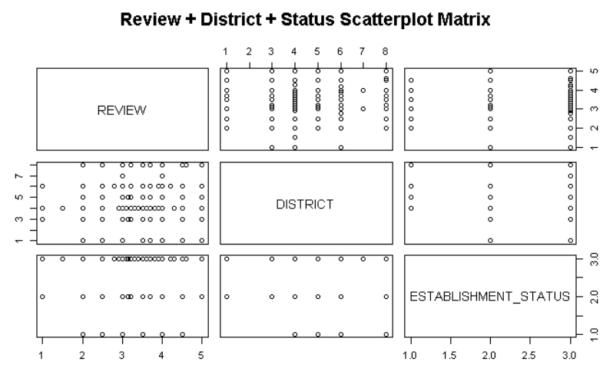
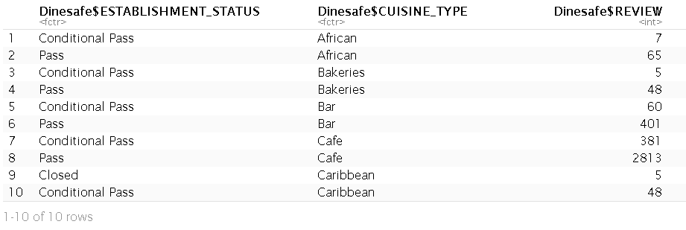
Multivariate data Analysis
More than two variables data analysis using simple scattered matrix and aggregated values

Slide 12
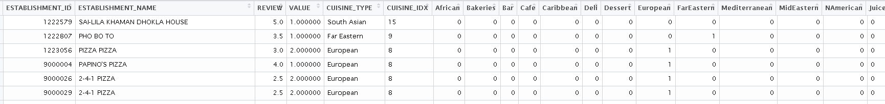
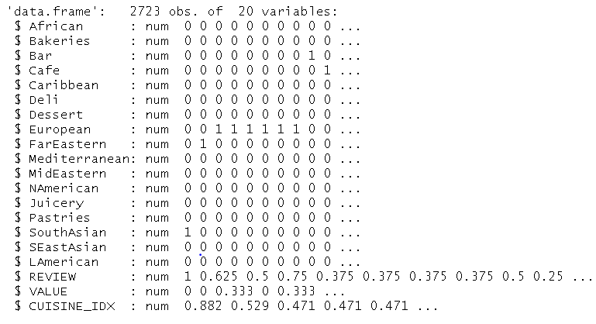
Data Transformation
Select variables to create a feature
Filter a unique rows in dataset
Convert “cuisine type” variable from categorical value to numerical non ordinal index value
Convert “cuisine type” index to binary value
Normalize “cuisine type”, “Review” & “Value” variables
Randomly split the dataset to training and testing

Slide 13
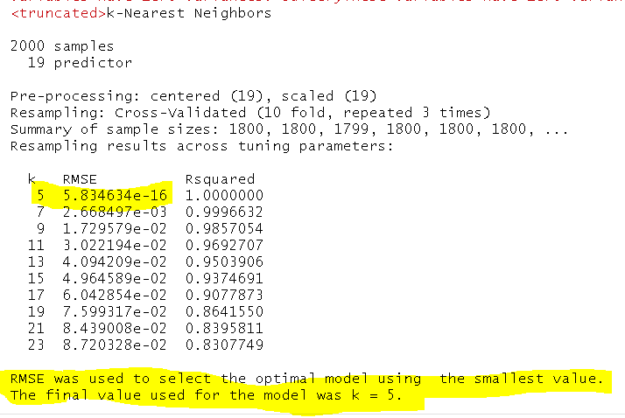
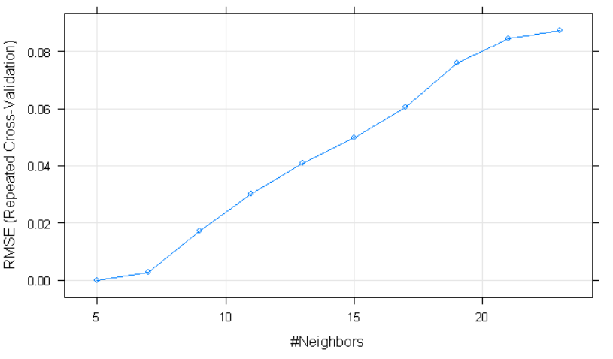
Predictive Analysis
In these capstone project a city of Toronto Dinesafe food
Algorithm Selection: Supervised Learning Algorithm with KNN
Model Building: 10 fold cross validation to identify most optimized K value with least RMSE error value

Slide 14
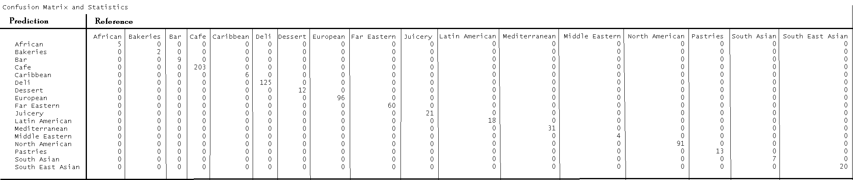
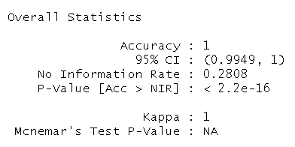
Predictive Analysis
Prediction:
model <- knn(train = Dine_train, test = Dine_test, cl = Dine_trainLabel, k = 5)
Validation with confusion matrix with 100% accuracy

Slide 15
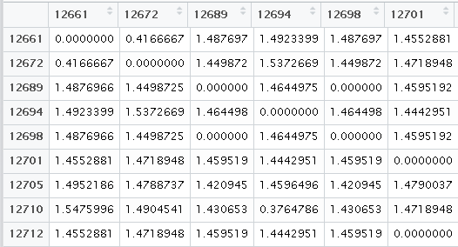
Recommender System
The most common technique used in a recommender system is identifying similarity between two items feature vectors based on how close it is distance. The smaller the distance implies a higher similarity.
The distance between two items is calculated using the euclidean distance formula
distances <- as.matrix(dist(recommender , method="euclidean"))

Slide 16
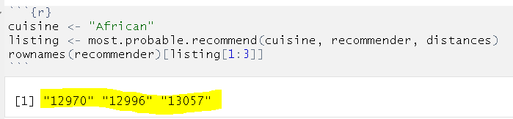
Recommender System
Recommend three restaurants with African cuisine based on the recommender matrix and Euclidian distance between each items. The recommender output are restaurant id “12970”, “12996” & “13057”
This is a good example of content based recommender system where similarities are defined by item attributes in the absence of user profile. This recommender type is used to overcome cold start.

Slide 17
Conclusion
In these exercise the following tasks were accomplished
Data exploration & preparation
Data analysis
Predictive analytics
Recommendation
Next Step
Improve the recommendation accuracy
Implement alternative supervised algorithm for recommender system

